Slide 1
Customer Churn Visuals
File created on: 1/8/2024 10:06:50 AM

Slide 2
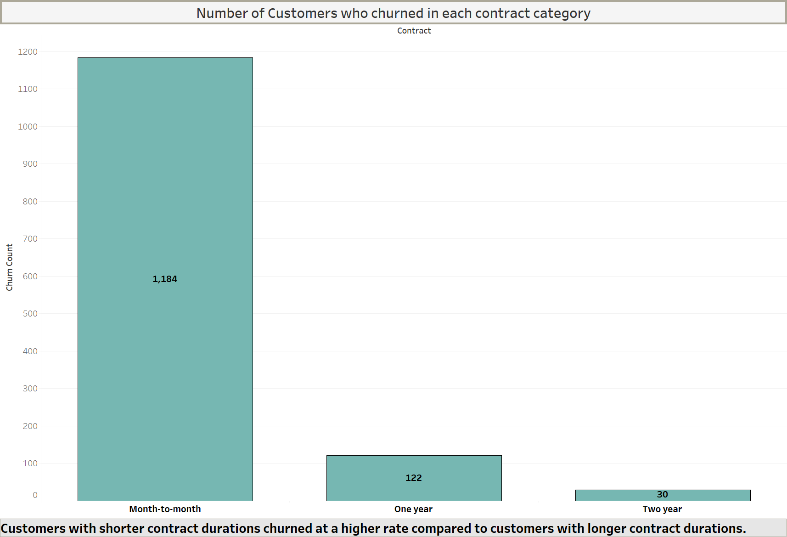

Slide 3
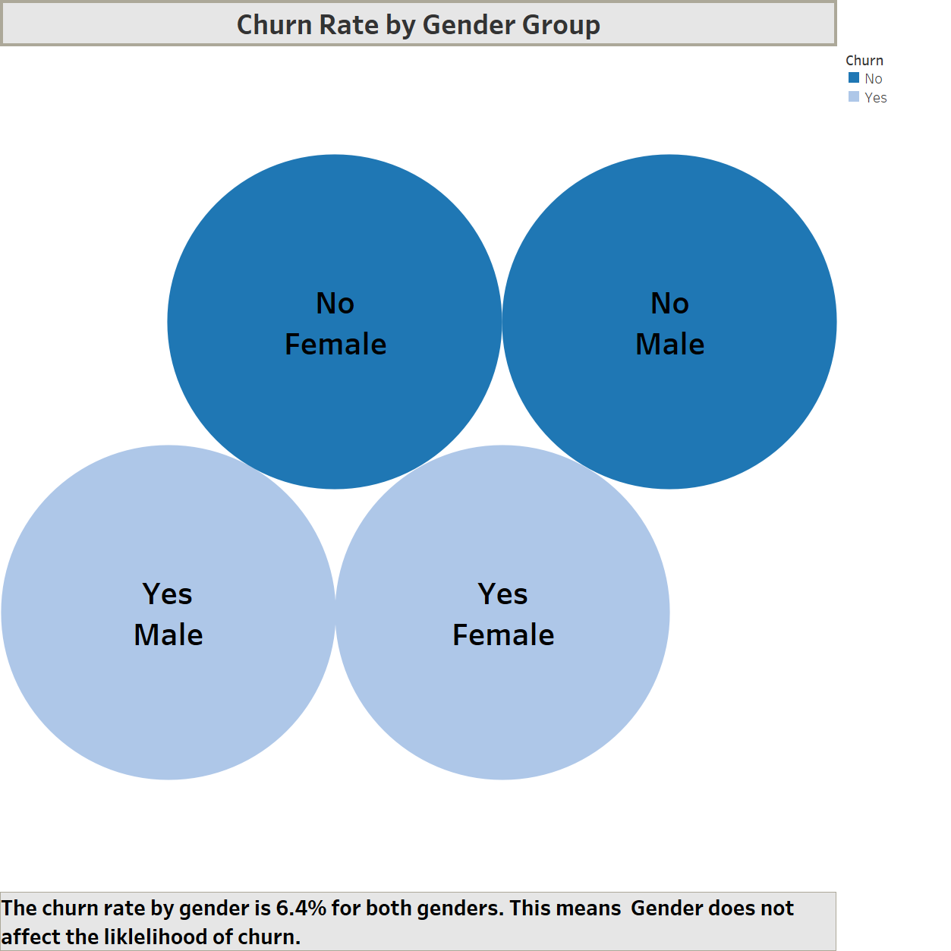

Slide 4
